Slide 1
Chapter II
Problem Solving, Search and Control Strategies

Slide 2
Steps for solving a problem
Define the problem precisely
  Specifications of initial situation(s) and final situation(s)
    Is there a single or multiple goals?
    If there is a single goal, can it be split into pieces?
    If there are several goals or subgoals, are they independent or are they connected?
    Are there any constraints on developing a solution?
Analyze the problem
Isolate and represent task knowledge
Choose the best problem solving technique and use.

Slide 3
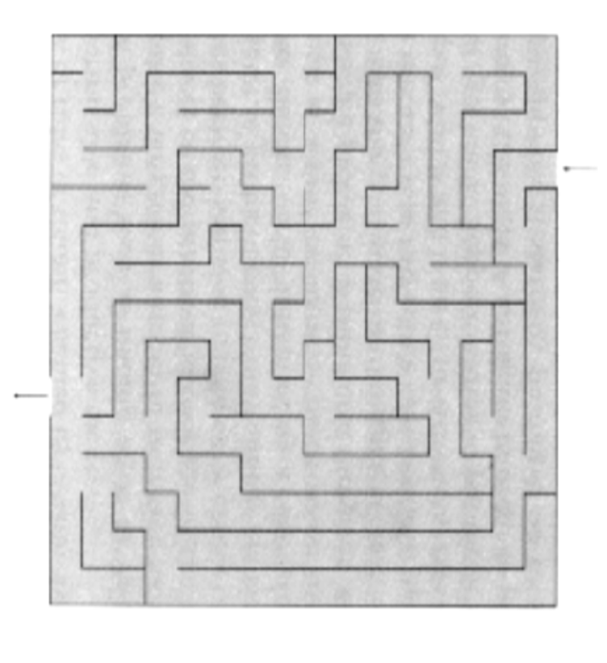
Problem Space
a complete set of possible states, generated by exploring all possible steps, or moves, which may or may not lead from a given state or start state to a goal state.

Slide 4
Example
Problem
  Play Chess
Initial State (single)
  8 x 8 array containing a symbol representing the respective piece in the opening position.
Goal State (multiple)
  Any board position where the opponent does not have any legal move and his/her king is under attack.
Rules
  Legal moves for moving from one state to another
  Left hand side acts as a pattern to match
  Right hand side describes the changed state.

Slide 5
Formal Description of a Problem
State Space
  Define a state space that contains all the possible configurations of the relevant objects.
Initial States
  Specify one or more states within that space as possible situations from which the problem-solving can start.
Goal States
  Specify one or more states that would be acceptable as solutions to the problem
Operators
  Specify a set of rules/functions (operators) that transform from one state to another, within the constraints of the search problem

Slide 6
Blocks Rearrangement Problem
C
A
A
B
B
C

Slide 7
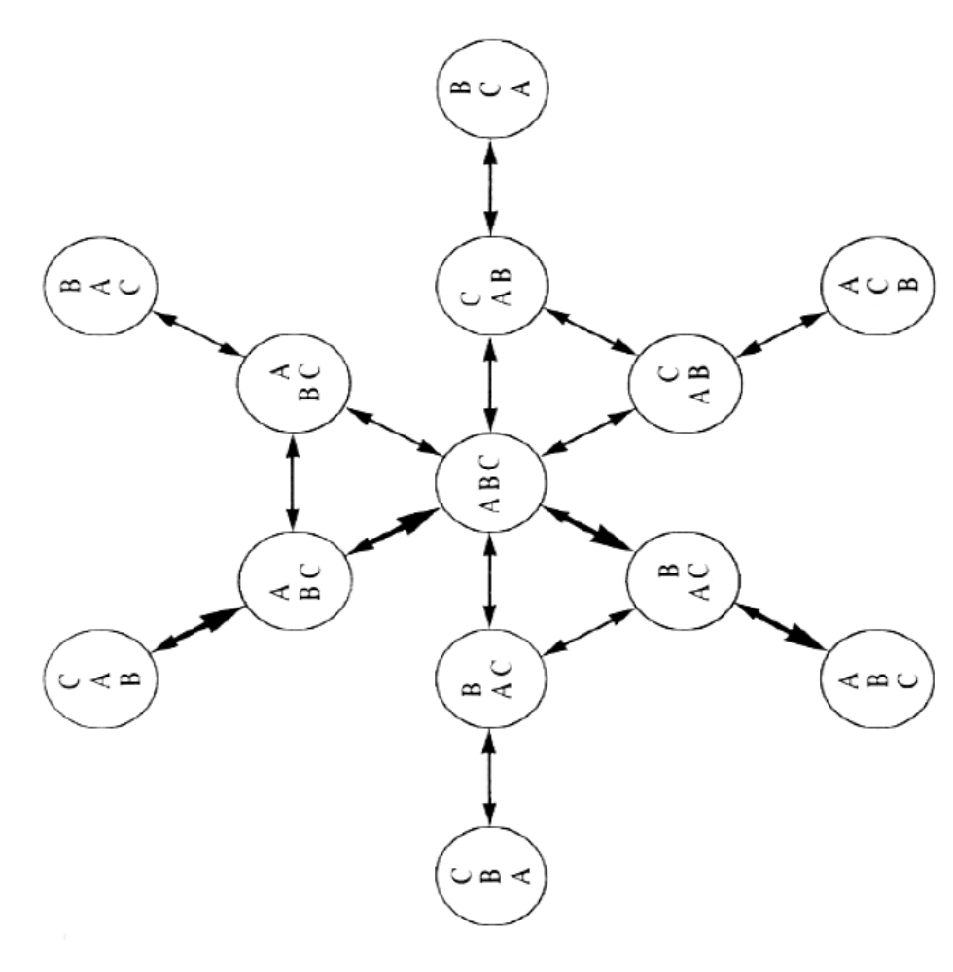
State Space Graph

Slide 8
Water Jug Problem
You are given two jugs, a 4 lt. one and a 3 lt. one. Neither has any measuring markers on it. There is a pump that can be used to fill the jugs with water. How can you get exactly 2 lt. of water into the 4lt. one?

Slide 9
Solution
State space
  Set of ordered pairs (x,y) such that x=0,1,2,3,4 and y=0,1,2,3
  x represents the amount of water in the 4 lt. jug and y represents the amount of water in the 3 lt. jug.
Initial State
  (0,0) : both jugs are empty.
Goal/Final state
  (2,n) : 2 lts. In Jug 1 (4 lt.) and n lts. in Jug 2 (3 lts)

Slide 10
Solution (Operators)
1 | (x,y) if x<4 | (4,y) | Fill the 4 lt Jug
2 | (x,y) if y<3 | (x,3) | Fill the 3 lt Jug
3 | (x,y) if x>0 | (x-d,y) | Pour some water from the 4 lt jug
4 | (x,y) if y>0 | (x,y-d) | Pour some water from the 3 lt jug
5 | (x,y) if x>0 | (0,y) | Empty the 4 lt jug on the ground
6 | (x,y) if y>0 | (x,0) | Empty the 3 lt jug on the ground
7 | (x,y) if x+y>=4 and y>0 | (4,y-(4-x)) | Pour water from the 3 lt jug to the 4 lt jug till the 4 lt jug is full
8 | (x,y) if x+y>=3 and x>0 | (x-(3-y),3) | Pour water from the 4 lt jug to the 3 lt jug till the 3 lt jug is full
9 | (x,y) if x+y<=4 and y>0 | (x+y,0) | Pour all the water from the 3 lt jug to the 4 lt jug.
10 | (x,y) if x+y<=3 and x>0 | (0,x+y) | Pour all the water from the 4 lt jug to the 3 lt jug.
11 | (0,2) | (2,0) | Pour the 2 lts from the 3 lts jug to the 4 lts jug
12 | (2,y) | (0,y) | Empty the 2 lts in the 4 lt jug on the ground

Slide 11
One possible solution
Quantity in 4 lt Jug | Quantity in 3 lt Jug | Rule applied
0 | 0 | Initial state
0 | 3 | 2
3 | 0 | 9
3 | 3 | 7
4 | 2 | 5 or 12
0 | 2 | 9 or 11
2 | 0 | Goal state

Slide 12
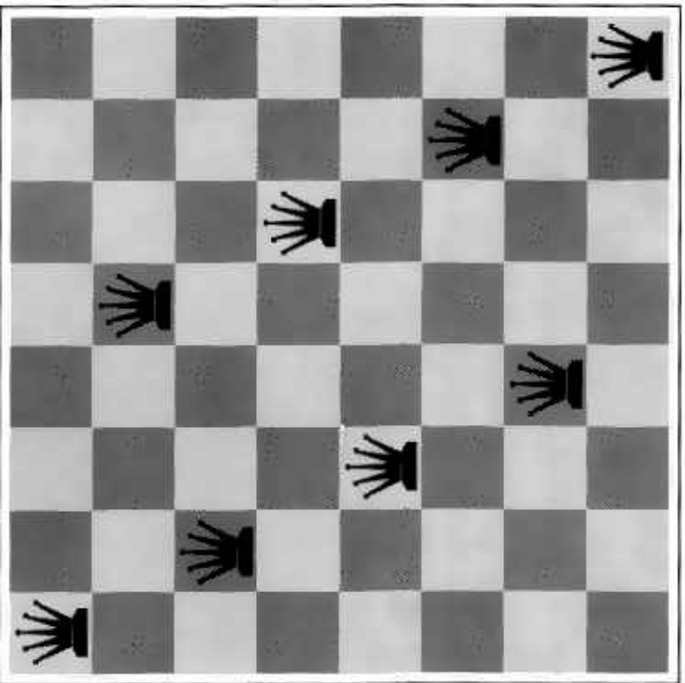
Eight Queens Problem
8 queens on a chess board
No queen attacked
  No two queens in the same row/column/diagonal.
States:
  any arrangement of 0 to 8 queens on the board.
Operators:
  add a queen to any square

Slide 13
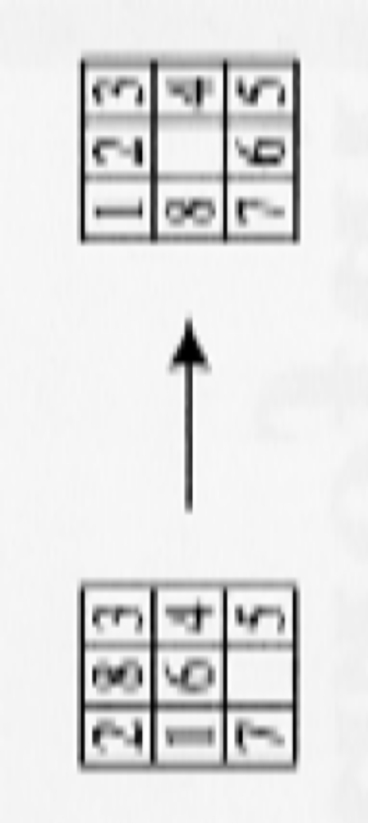
Eight Puzzle Problem
Start
Goal
Multiple start states.

Slide 14
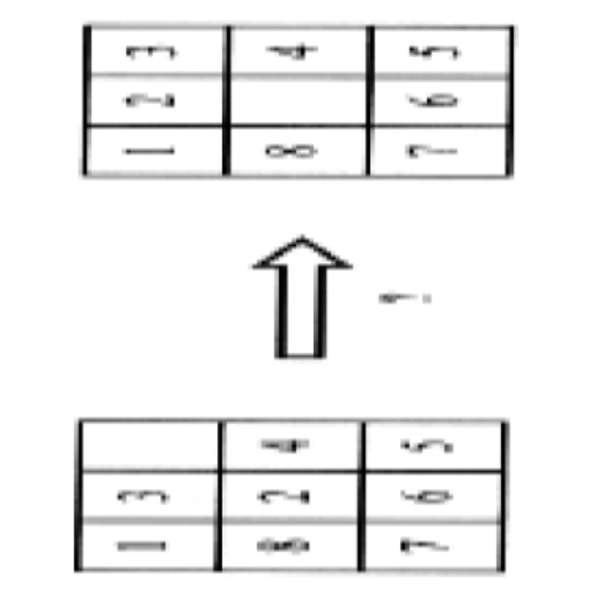
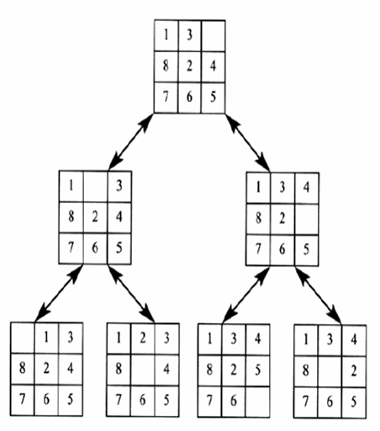
Eight Puzzle Problem

Slide 15
Production System
Consists of
  A set of rules, each containing a left side that determines applicability of the rule and a right hand side that describes the operation to be performed if that rule is applied.
  One or more knowledge/database that contains whatever information is appropriate for the particular task.
  A control strategy that specifies the order in which the rules will be compared to the database and a way of resolving the conflicts that arise when several rules match at once.
  A rule applier

Slide 16
Production system
In order to solve a problem:
We must first reduce it to one for which a precise statement can be given. This can be done by defining the problem’s state space ( start and goal states) and a set of operators for moving that space.
The problem can then be solved by searching for a path through the space from an initial state to a goal state.
The process of solving the problem can usefully be modeled as a production system.

Slide 17
Control Strategies
How to decide which rule to apply next during the process of searching for a solution to a problem?
The two requirements of good control strategy are that
  it should cause motion.
  It should be systematic

Slide 18
Search Problem
Informal description
  Problem formulation
    Consider all relevant set of states
    Operators to move from one state to another.

Slide 19
Search Problem : Formal
A search problem can be represented by a 4-tuple (S,s⁰ ,A,G)
  S: the full set of states
  s⁰ : the initial state
  A:S→S is a set of operators
  G is the set of final states. Note that G ⊆S
The search problem is to find a sequence of actions to transform from the initial state to a goal state .

Slide 20
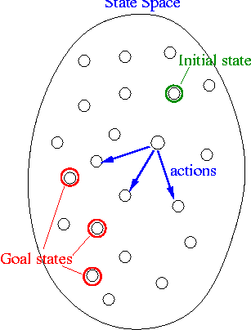
Search Problem : schematic diagram

Slide 21
Representation of Search problems
As directed graphs
  Nodes represent states
  Arcs represents actions on states.

Slide 22
Basic Search Algorithm : Data Structures
Node
  State
  Parent state
  Operation applied to arrive at this state.
Fringe
  List of nodes already generated but not explored.

Slide 23
Basic Search Algorithm
Let L be a list containing the initial state (L=the fringe)
Loop
if L is empty return failure
Node select (L)
if Node is a goal then return Node
(the path from initial state to Node)
else
generate all successors of Node, and merge the newly generated states into L
End Loop

Slide 24

Tree search example

Slide 25

Tree search example

Slide 26

Tree search example

Slide 27
Key issues in search problems
What if search tree is unbounded?
What if the search tree contain loops?
Should we return a node or a path?
How do we select a node for expansion?
How do we add the expanded nodes in the fringe?

Slide 28
Search strategies
A search strategy is defined by picking the order of node expansion
Strategies are evaluated along the following dimensions:
  completeness:
    does it always find a solution if one exists?
  time complexity
    number of nodes generated
  space complexity
    maximum number of nodes in memory
  Optimality
    does it always find a least-cost solution?

Slide 29
Search Strategies
Blind Search Strategies or uninformed search
  Depth First Search
  Breadth First Search
  Iterative Deepening

Slide 30
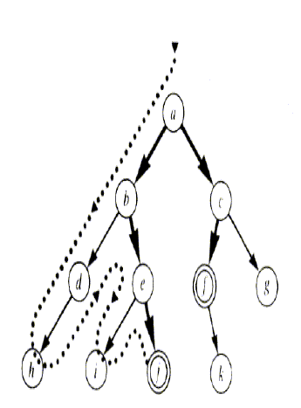
Depth First Search

Slide 31
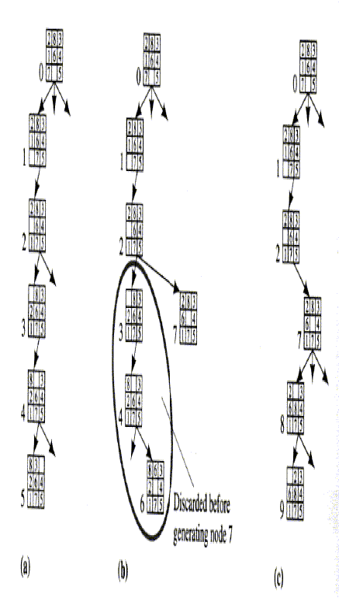
DFS : Eight Puzzle Problem

Slide 32
Algorithm: Depth First Search
If the initial state is a goal state, quit and return success
Otherwise, do the following until success or failure is signaled:
  Generate a successor, E, of initial state. If there are no more successors, signal failure.
  Call Depth-First Search, with E as the initial state
  If success is returned, signal success. Otherwise continue in this loop.

Slide 33
Backtracking
In DFS, we pursue a single branch of the tree until it yields a solution or until a decision to terminate the path is made.
It makes sense to terminate a path if it reaches dead-end, produces a previous state or becomes longer than some predefined futility value. In such a state backtracking occurs
Chronological Backtracking:
  Order in which steps are undone depends only on the temporal sequence in which steps were initially made.
  Specifically most recent step is always the first to be undone.

Slide 34
Properties of Depth First Search
Requires less memory as only the nodes on the current path are stored.
Does not guarantee a solution.
Can get stuck in a blind alley.
Specially useful in cases where multiple goals exist.

Slide 35
Breadth First Search
  Create a variable called NODE-LIST and set it to initial state
  Until a goal state is found or NODE-LIST is empty do
    Remove the first element from NODE-LIST and call it E. If NODE-LIST was empty, quit
    For each way that each rule can match the state described in E do:
      Apply the rule to generate a new state
      If the new state is a goal state, quit and return this state
      Otherwise, add the new state to the end of NODE-LIST

Slide 36
BFS Tree for Water Jug problem
(0,0)
(4,0)
(0,3)
(0,0)
(1,3)
(4,3)
(0,0)
(3,0)
(4,3)
NODE_LIST : (0,0)

Slide 37
BFS Tree for Water Jug problem
(0,0)
(4,0)
(0,3)
(0,0)
(1,3)
(4,3)
(0,0)
(3,0)
(4,3)
NODE_LIST : (0,0),(4,0),(0,3)

Slide 38
BFS Tree for Water Jug problem
(0,0)
(4,0)
(0,3)
(0,0)
(1,3)
(4,3)
(0,0)
(3,0)
(4,3)
NODE_LIST : (4,0),(0,3)

Slide 39
BFS Tree for Water Jug problem
(0,0)
(4,0)
(0,3)
(0,0)
(1,3)
(4,3)
(0,0)
(3,0)
(4,3)
NODE_LIST : (0,3),(4,3),(0,0),(1,3)

Slide 40
BFS Tree for Water Jug problem
(0,0)
(4,0)
(0,3)
(0,0)
(1,3)
(4,3)
(0,0)
(3,0)
(4,3)
NODE_LIST : (4,3),(0,0),(1,3),(4,3),(0,0),(3,0)

Slide 41
Properties of Breadth First Search
BFS will not get trapped exploring a blind alley.
If there is a solution, BFS is guaranteed to find it.
If there are multiple solutions, then a minimal solution will be found.
Requires the generation and storage of the tree

Slide 42
Iterative Deepening Search
Successive Depth First search is carried out with depth cutoff starting from 0 and increasing by 1.

Slide 43
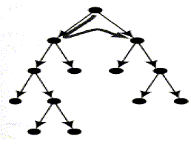
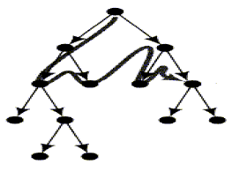
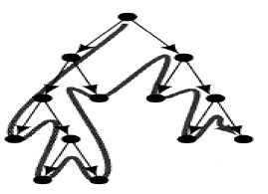
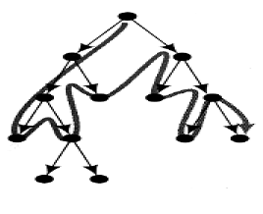
Iterative Deepening Search
D=2
D=1
D=3
D=4

Slide 44
Properties of Iterative Deepening
Guarantees a solution.
Optimal if all costs are equal.

Slide 45
Problem Characteristics
Is the problem decomposable into a set of independent smaller or easier subproblems?
Can solution steps be ignored or at least undone if they prove unwise?
Is the problem’s universe predictable?
Is a good solution to the problem obvious without comparison to all other possible solutions?
Is the desired solution a state of the world or a path to a state?
Is a large amount of knowledge absolutely required to solve the problem or is knowledge important only to constrain the search?
Can a computer that is simply given the problem return the solution or will the solution of the problem require interaction between the computer and a person?

Slide 46
Is the problem decomposable?
Start: ON(C,A)
A
C
B
Goal:
ON(B,C) and ON(A,B)
A
B
C
Operators
CLEAR(x) [ block x has nothing on it]-> ON(x, Table)
CLEAR(x) and CLEAR(y) -> ON(x,y) [ put x on y]

Slide 47
Solution to Blocks Problem
ON(B,C) and ON(A,B)
ON(B,C)
ON(A,B)
Put B on C
CLEAR(A)
ON(A,B)
ON(B,C)
Move a to table
Put A on B
CLEAR(A)
ON(A,B)

Slide 48
Can Solution Steps be ignored or undone?
Theorem proving
  Suppose we are trying to prove a math theorem. We can prove a lemma. If we find the lemma is not of any help, we can still continue.
8-puzzle problem
  to undo a move, we need to undo several other moves.
  Need to keep track of previous moves.
Chess
  A move cannot be taken back.

Slide 49
Contd..
Important classes of problems:
  Ignorable ( Theorem proving)
  Recoverable ( 8-puzzle)
  Irrecoverable ( Chess)
The recoverability of a problem plays an important role in determining the complexity of the control structure necessary for the problem’s solution.
  Ignorable problems
    can be solved using a simple control structure that never backtracks
  Recoverable problems
    Control strategy requires backtracking
    Can be implemented as a push down stack that records moves.
  Irrecoverable problems
    will need to be solved by systems that expends a great deal of effort/planning making each decision since decision must be final.

Slide 50
Is the universe predictable?
In some problems like 8-puzzle, we can design a strategy or set of moves which guarantee a win.
Possible as there is no uncertainty.
Planning process not possible is problems with uncertainty like bridge.
At best, we can explore several plans and use probabilities of various outcomes and select the one with the highest probability of winning.
Plan revision process important.

Slide 51
Is a good solution relative or absolute?
Any path problem
Best path problem
Any path problems can often be solved in a reasonable amount of time by using heuristics that suggest good paths to explore.
Best path problems are computationally harder.

Slide 52
Is the solution a path or a state?
Examples
  8-puzzle problem
    The solution will only consist of the solved puzzle and not the steps that led to the solution.
  Water Jug problem
    The solution not only requires the 4 lt. jug to contain 2 lt. but also the sequence of steps to reach this state.

Slide 53
What is the role of knowledge?
Example
  Chess problem
    Given unlimited computing resources, very little knowledge is required to solve the problem. Only rules for legal moves is required.
  Scan a book to find how many topics are of interest to 4th semester MCA students
    Names of topics of interest to MCA students
    Sub topics of these topics

Slide 54
Does the task require interaction with a person?
Two types of problems
  Solitary
    Computer is given a problem description and produces an answer with no intermediate communication and no demand for an explanation of the reasoning process
  Conversational
    Intermediate communication between a person and the computer, either to provide additional assistance to the computer or to provide additional information to the user, or both.

Slide 55
Problem Classification
Based on the pervious questions, we can classify problems into broad classes and associate a generic control strategy for solving these problems.
Classification
  Examine input and decide the class to which the problem belongs. Eg. Medical diagnosis.
Propose and Refine
  Eg. Planning and design problems

Slide 56
Production System Characteristics
Can production systems, like problems, be described by a set of characteristics that shed some light on how they can easily be implemented?
If so, what relationships are there between problem types and the types of production systems best suited to solving the problems?

Slide 57
Monotonic Production Systems
Production system in which the application of a rule never prevents the later application of another rule that could also have been applied at the time the first rule was applied.
i.e., rules are independent.

Slide 58
Non- monotonic production system
Production system which does not exhibit monotonicity.

Slide 59
Partially Commutative Production System
If application of a particular sequence of rules changes state x to state y, then any permutation the those allowable rules also transforms state x to state y.

Slide 60
Commutative Production system
A Commutative production system is a production system that is both monotonic and partially commutative.

Slide 61
Four Categories of Production System
 | Monotonic | NonMonotonic
Partially Commutative | Theorem proving | Robot Navigation
Not Partially Commutative | Chemical Synthesis | Bridge

Slide 62
Partially Commutative, Monotonic
These production systems are useful for solving ignorable problems.
Example: Theorem Proving
They can be implemented without the ability to backtrack to previous states when it is discovered that an incorrect path has been followed.
This often results in a considerable increase in efficiency, particularly because since the database will never have to be restored, It is not necessary to keep track of where in the search process every change was made.
They are good for problems where things do not change; new things get created.

Slide 63
Non Monotonic, Partially Commutative
Useful for problems in which changes occur but can be reversed and in which order of operations is not critical.
Example: Robot Navigation, 8-puzzle, blocks world
Suppose the robot has the following ops: go North (N), go East (E), go South (S), go West (W). To reach its goal, it does not matter whether the robot executes the N-N-E or N-E-N.

Slide 64
Not partially Commutative
Problems in which irreversible change occurs
Example: chemical synthesis
The ops can be :Add chemical x to the pot, Change the temperature to t degrees.
These ops may cause irreversible changes to the potion being brewed.
The order in which they are performed can be very important in determining the final output.
(x+y) +z is not the same as (z+y) +x
Non partially commutative production systems are less likely to produce the same node many times in search process.
When dealing with ones that describe irreversible processes, it is partially important to make correct decisions the first time, although if the universe is predictable, planning can be used to make that less important.

Slide 65
Issues in the design of search programs
The direction in which to conduct the search (forward versus backward reasoning) i.e from initial state to goal state or vice versa.
How to select applicable rules (Matching)
How to represent each node of the search process ( knowledge representation problem)
Search tree verses search graphs.

